Slide 1
Using Transformers for skeleton-based action recognition
Alessandro Piazza – s4534114

Slide 2
Dataset
Downloaded through torch_skeleton library:
BABEL60/120
NTU60/120

Slide 3
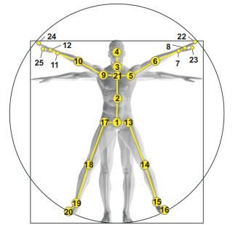
BABEL
60 (the most frequent) or 120 classes
150 frames with 25 keypoints
(x,y,z) as node features
Spatio-temporal edges

Slide 4
Actual samples
13220 samples
Training 60%, Validation 20%, Test 20%
Used_as_Training = 70% Training
Used_as_Validation = 30% Training
Used_as_Test = Validation

Slide 5
Second tentatives
GENeralized Graph Convolution (GENConv)
self.dropout = dropout
self.conv1 = GENConv(in_dim, 64, edge_dim=1)
self.conv2 = GENConv(64, 64, edge_dim=1)
self.conv3 = GENConv(64, 128, edge_dim=1)
self.dense1 = nn.Linear(128, 64)
self.dense2 = nn.Linear(64, out_dim)

Slide 6
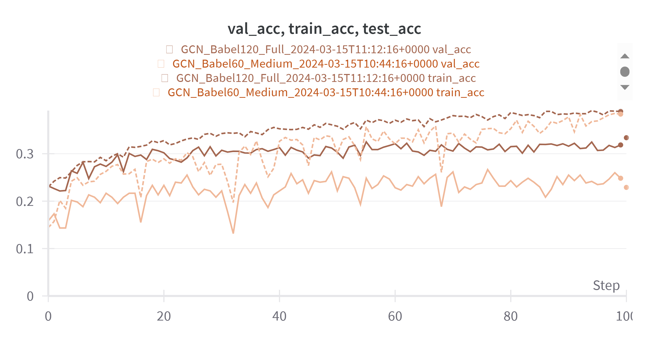

Slide 7
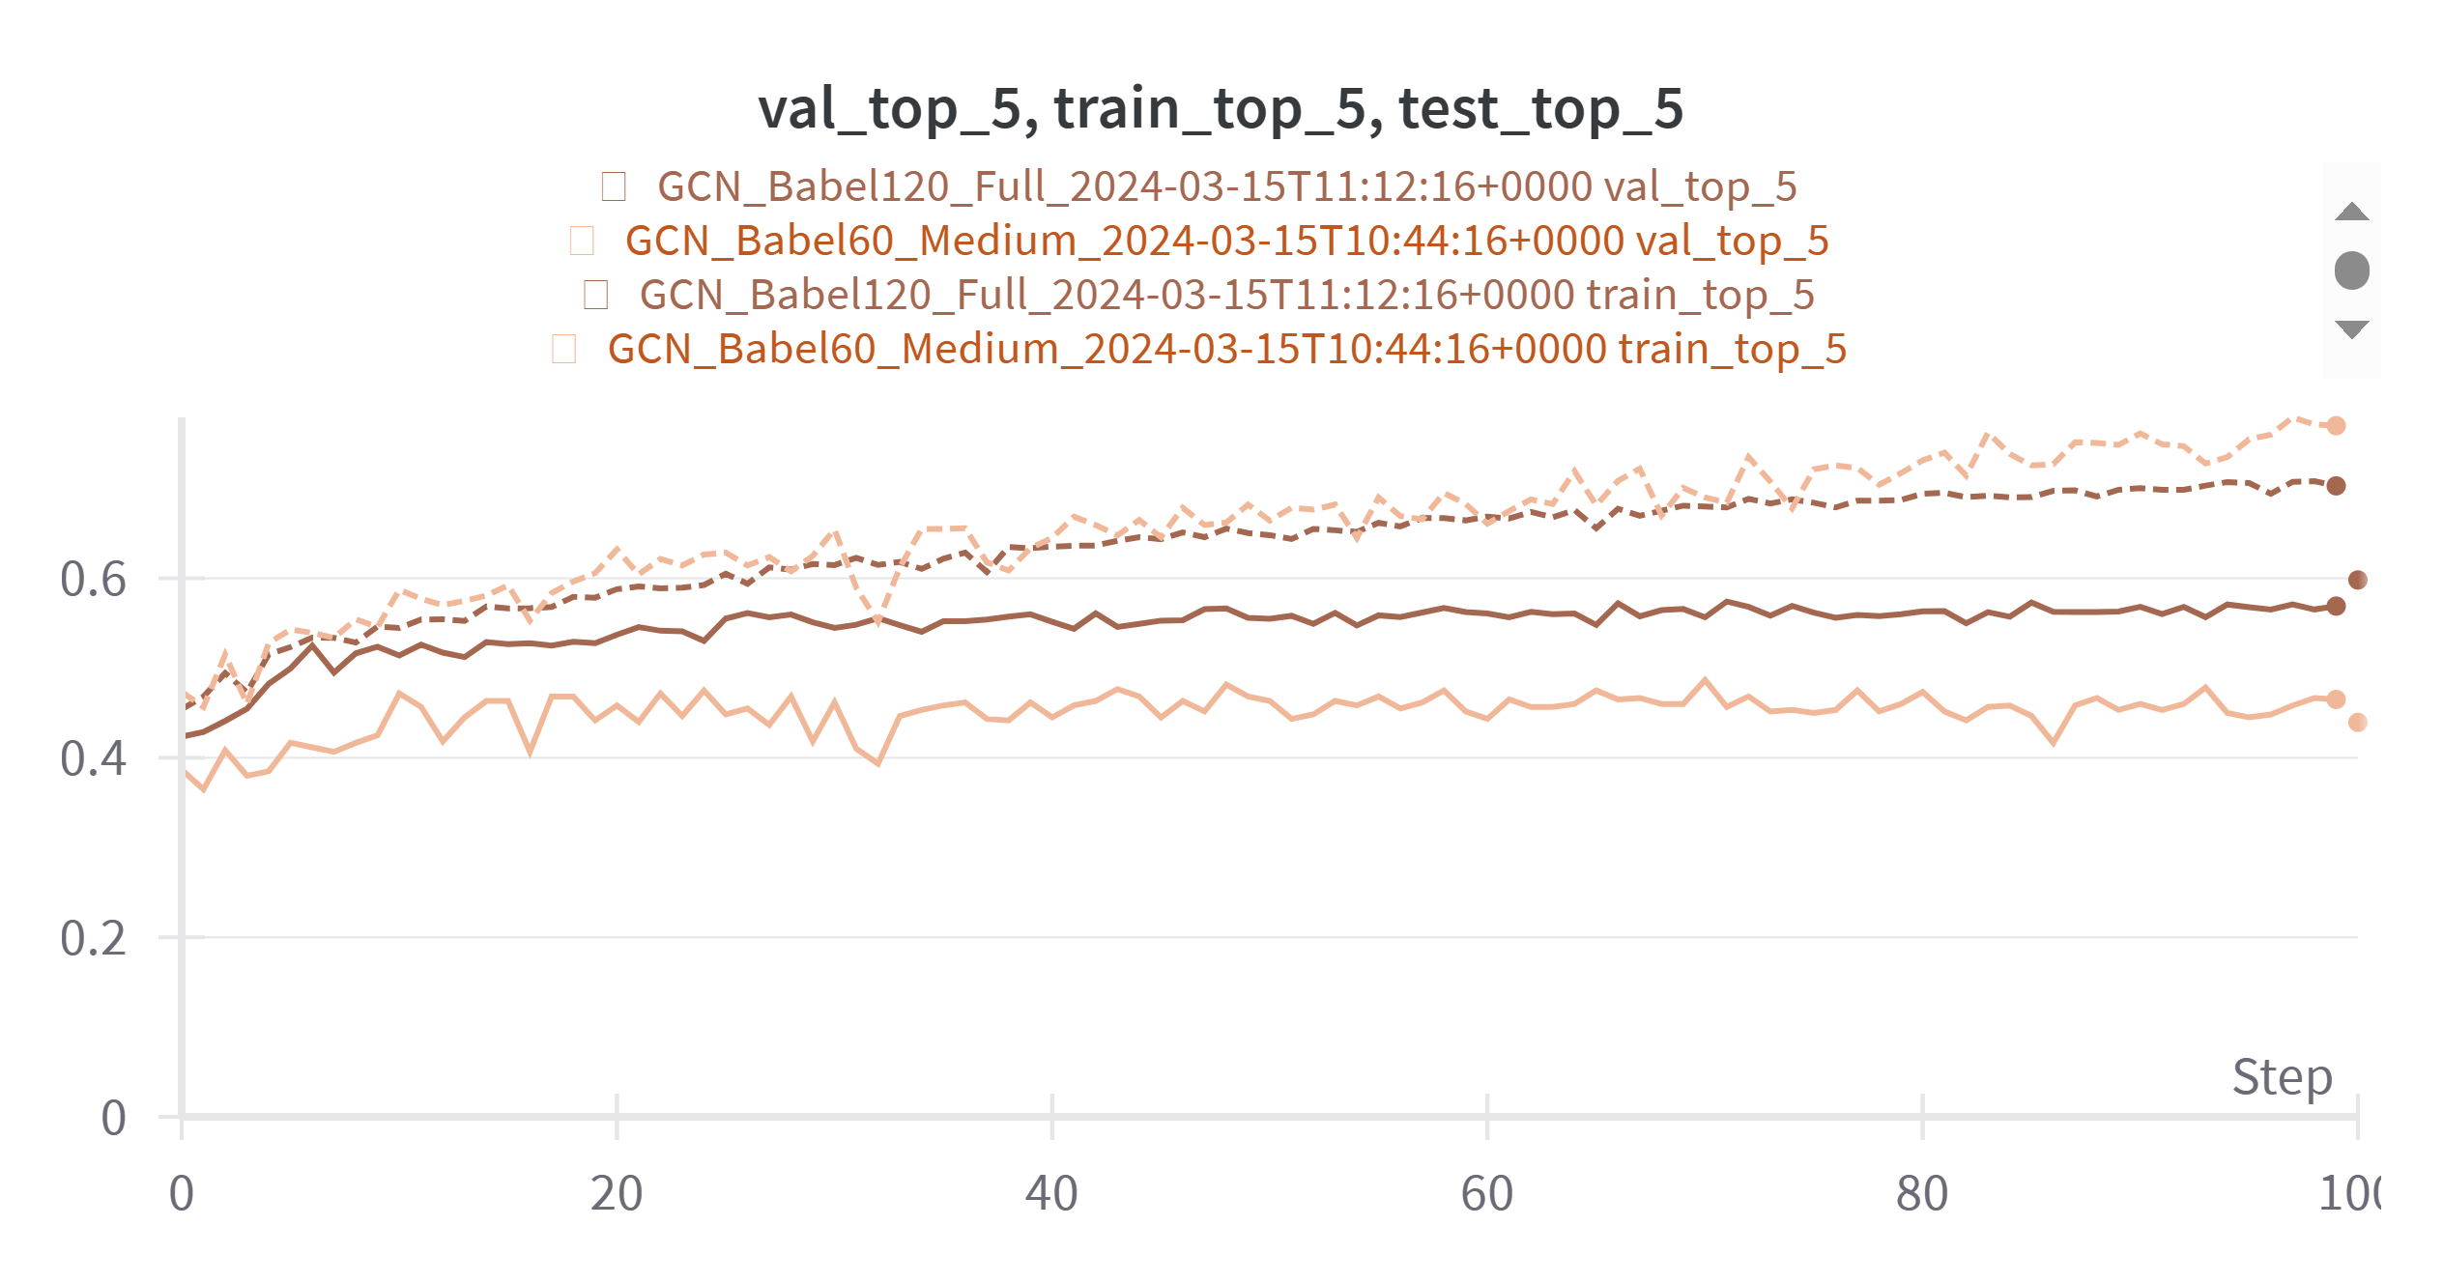

Slide 8
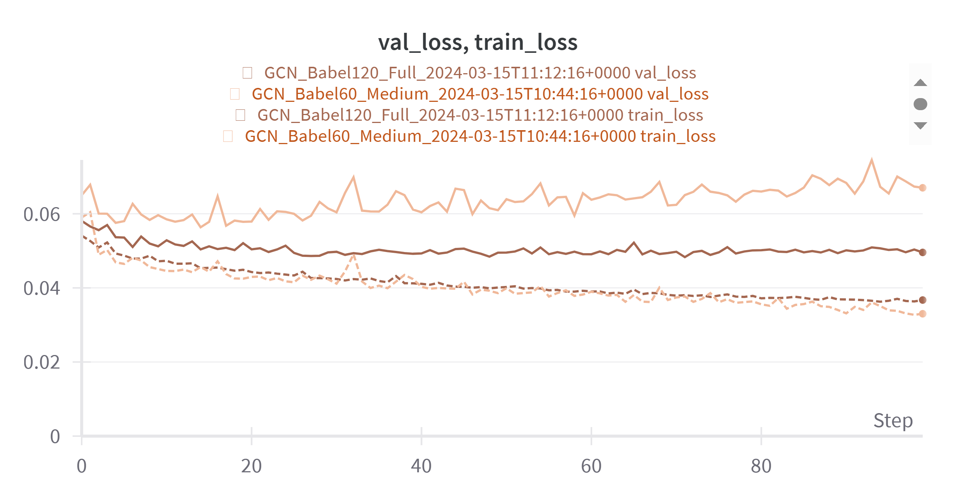

Slide 9
What’s next?
Real samples
Different more complex/deep architectures:
Developed by us?
From literature (like ST-GCN, 2s-AGCN…)?
NTU dataset
Introducing transformers in the pipeline
Enlarge node features
Edit loss
Fix data type and structures
Look for transformers
Visualize self-attention?
Edit classifier and look deeper the dimensions

